Slide 1
Cisco Organizational Learning
Learning from our mistakes
Mantra: Learn, Improve, Share
Implemented in subgroups in CDO, CVCM, etc.
Get it out to the org as a whole
Enterprise wide but not mandatory
Language issues – use a lot of L&D words
Notes:
Cisco Organizational Learning is a quality initiative. It has nothing to do with Learning & Development. It’s a methodology, processes, toolset that allows Cisco to learn from their mistakes, improve the way they do things in both the short and long run, then share their learnings with others so they improve as well.

Slide 2
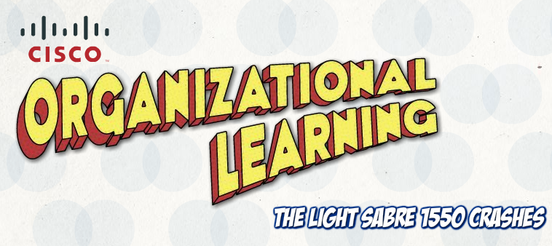
COL Intro
Compelling
Connect with hearts and guts
Use pictures and words
Serious cool factor
Get training to go “viral”
Notes:
Learn, Improve, Share is not rocket science. It just makes sense. We wanted this “training” to focus on getting at the hearts and guts of the audience. We needed a compelling story and treatment. The majority of the audience is engineers or tech types and it was felt that a graphic novel would be something they could relate to and understand.

Slide 3
How Much, Long, Made
$82.5k
  Total Available Market: 50k
Four weeks to agreed approach
  2 months for storyboard, alpha, beta, recording, final release
Using Flash
  Enspire tool set, format
  Added interactions to their base set
Notes:
It cost $82.5 k
It took 3 months to create
It was created in Flash

Slide 4
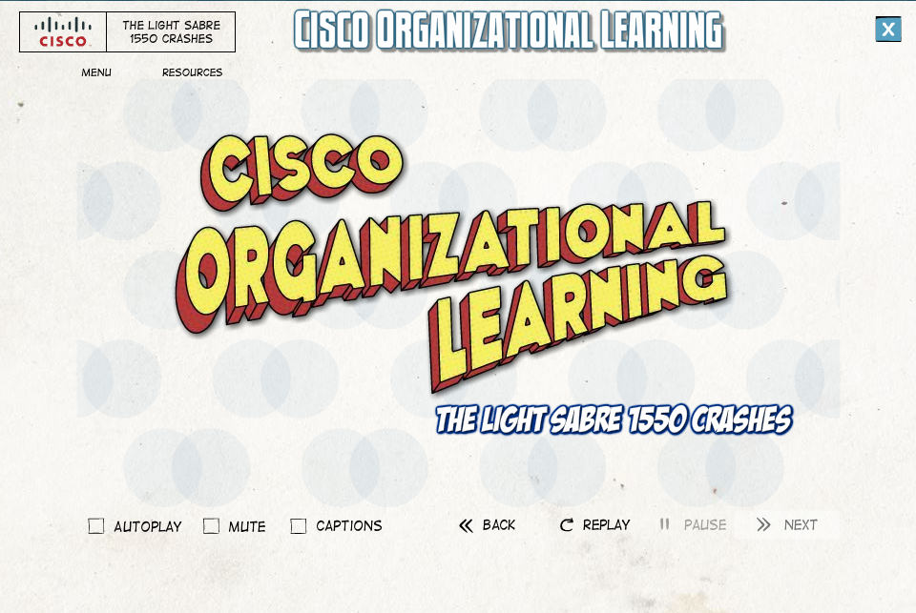
Notes:
Opening screen. The dots in the back “weave” back and forth and there is a bit of music that’s sort of mysterious sounding.

Slide 5
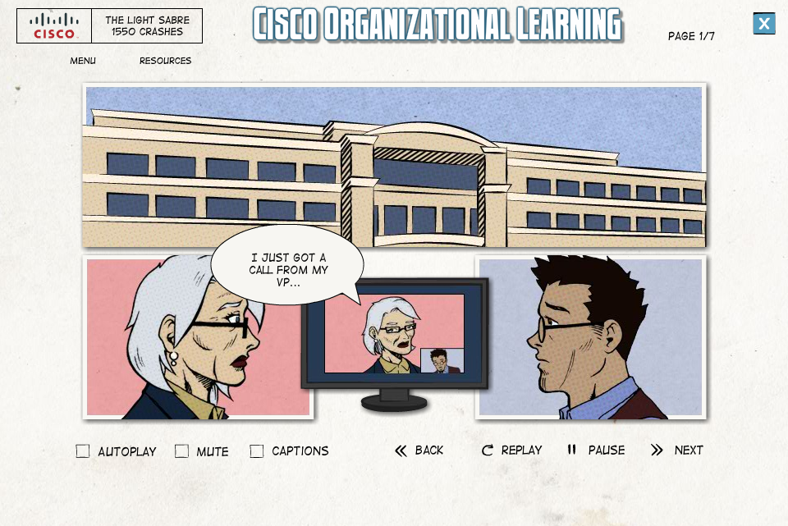
Notes:
Next screen – sets the story. Women on left is a customer and she’s calling her Cisco systems engineer because of piece of equipment has crashed – AGAIN!

Slide 6
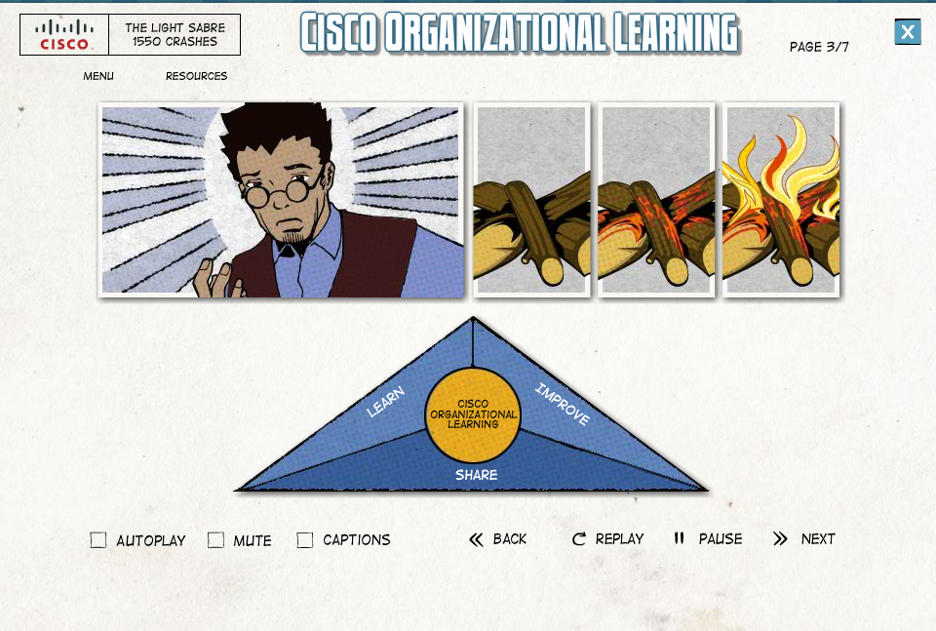
Notes:
The Systems Engineer knows that when things like this happen they go into fire fighting mode. However, there’s a better way. Cisco Organizational Learning and Learn, Improve, Share.

Slide 7
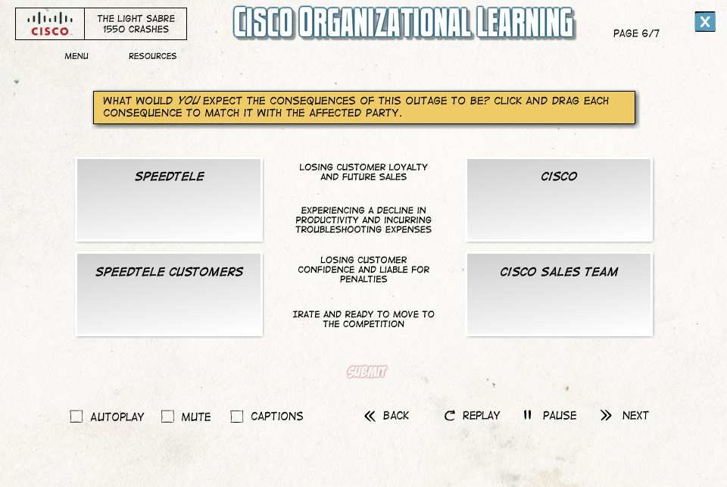
Notes:
Sample interaction. Learner gets two tries to click and drag before they are shown the answer.

Slide 8
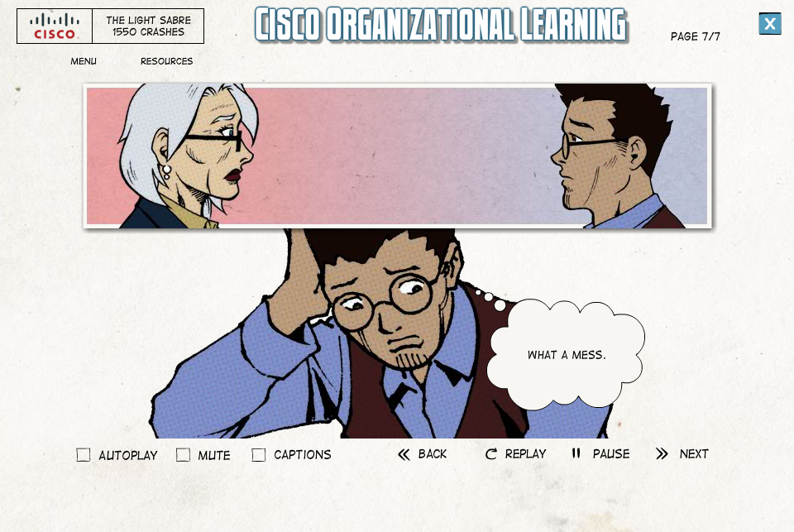
Notes:
This is a narrated story. There is a narrator as well as the characters having their own voices. The thought/speech bubbles just show the first few words of the audio vs. showing the complete text which is what would happen in a true graphic novel.

Slide 9
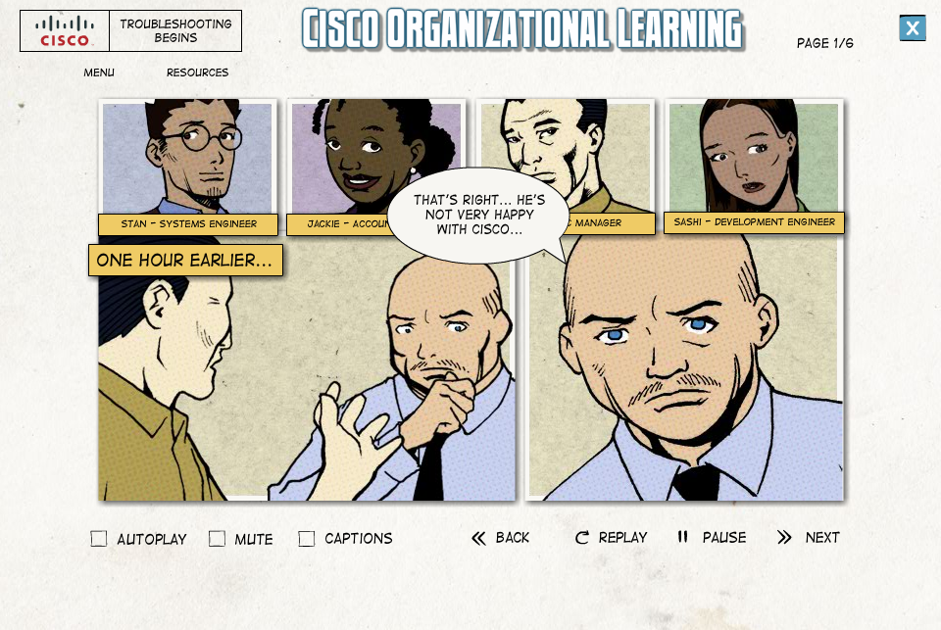
Notes:
This version of graphics uses the Silver Age style of “comic” book graphics.

Slide 10
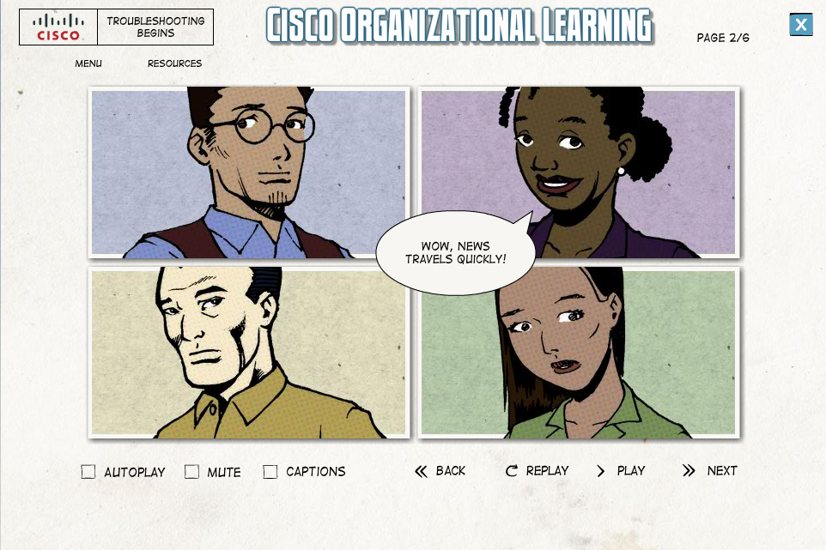
Notes:
Another screen capture

Slide 11
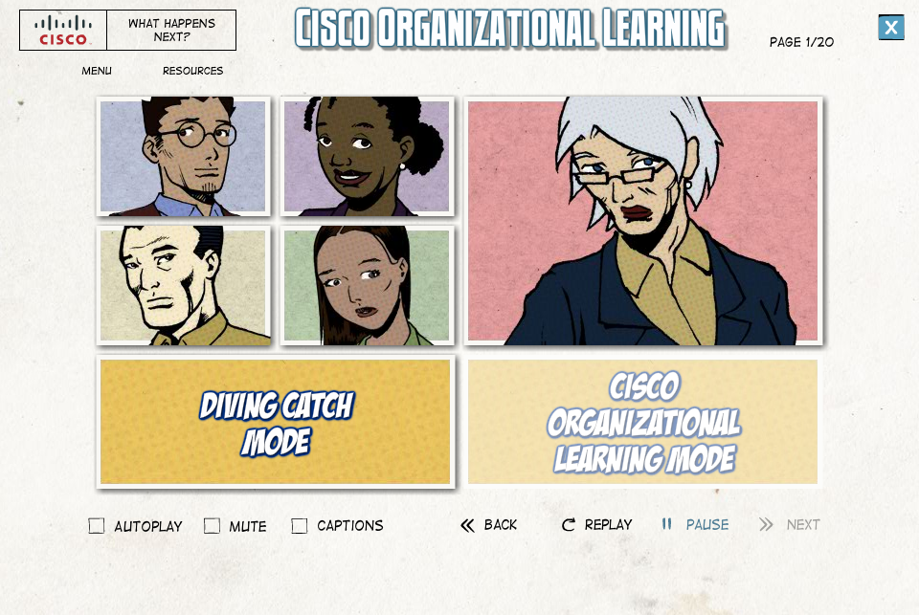
Notes:
There are two paths in the story. One that shows the results of this work using the old Diving Catch method. The other showing the results using the COL method. They are forced to take the first path then the are “routed” back to take the COL path.

Slide 12
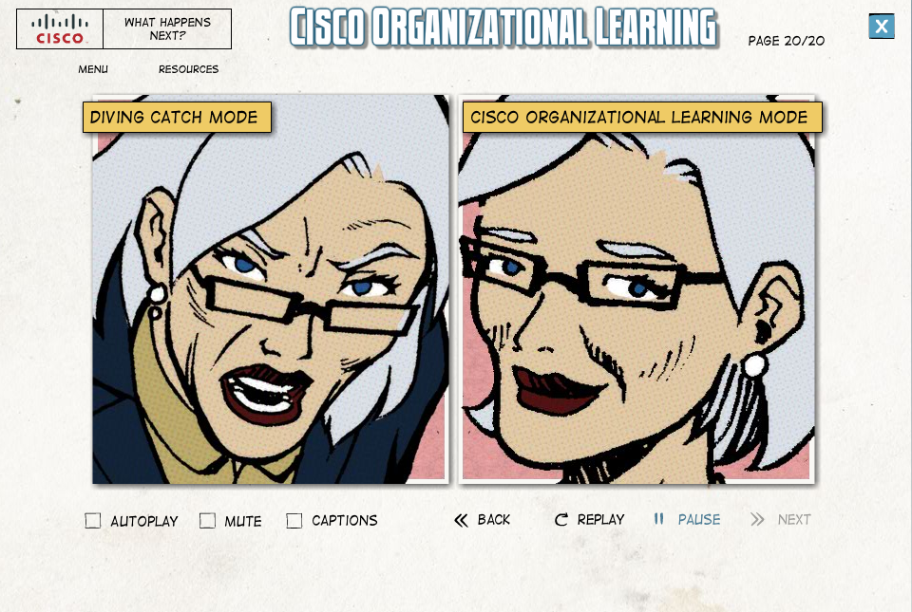
Notes:
Final screen. Once the story is done, there is a video of a recognized Cisco leader summarizing the main points, messaging the continued application of COL to the org and a call to action to participate in upcoming elearning.

